Slide 1
THE INSPIRATION OF THE BIBLE (Part 2)
2 Timothy 3:16-17

Slide 2
Evidences of Inspiration.
Fulfilled Prophecies
1. Prophecy is not a guess, a forecast, a calculation, a mere conjecture, a vague generalization, or an educated analysis of a forthcoming situation.
  a. Weather forecasters predict with about 60% accuracy.
  b. In Bible prophecy, 100% must come to pass. Fulfillment is the acid text.
  (Deuteronomy 18:9-22; Isaiah 41:22-23)
2. What is prophecy? A forth teller as well as a foreteller. cf. Exodus 7:1; 4:16

Slide 3
SPECIFIC PROPHECIES AND THEIR FULFILLMENT …
Israel in prophecy …
a. To receive a certain land (Genesis 15:18;
cf. Joshua 21:43ff; Nehemiah 9:7-8).
b. To lose the land (Deuteronomy 4:25-26;
Joshua 23:14ff; cf. 2 Kings 17:4-6; 24:10).
c. Remnant to be restored (Deuteronomy 30:1-10) after 70 years (Jeremiah 29:10-14;
cf. 2 Chronicles 36:23; Ezra 1:3; 9:6-15).
  (1) To be released by Cyrus (Isaiah 44:28-45:1).
All fulfilled.

Slide 4
SPECIFIC PROPHECIES AND THEIR FULFILLMENT …
Tyre in prophecy … Ezekiel 26 (Ezekiel taken captive about 597 BC)
Strongholds to be destroyed (verse 4).
Many nations to come up against her (verse 3).
Dust to be scraped until bare as the top of a rock
(verse 4).
Ruins provide place for spreading of nets (verse 5).
Ruins of city to be dumped in the water
(verses 12, 19).
To be desolate and uninhabited, never rebuilt
(verses 14, 19).

Slide 5
SPECIFIC PROPHECIES AND THEIR FULFILLMENT …
Tyre in prophecy … Ezekiel 26 (Ezekiel taken captive about 597 BC)
All Fulfilled:
Mainland Tyre besieged and destroyed by Nebuchadnezzar in 585-572 BC.
Island city destroyed by Alexander the Great in 332 BC. Built causeway from ruins of mainland city.
Today fishermen dry their nets on the Causeway … Mainland Tyre never has been rebuilt.

Slide 6
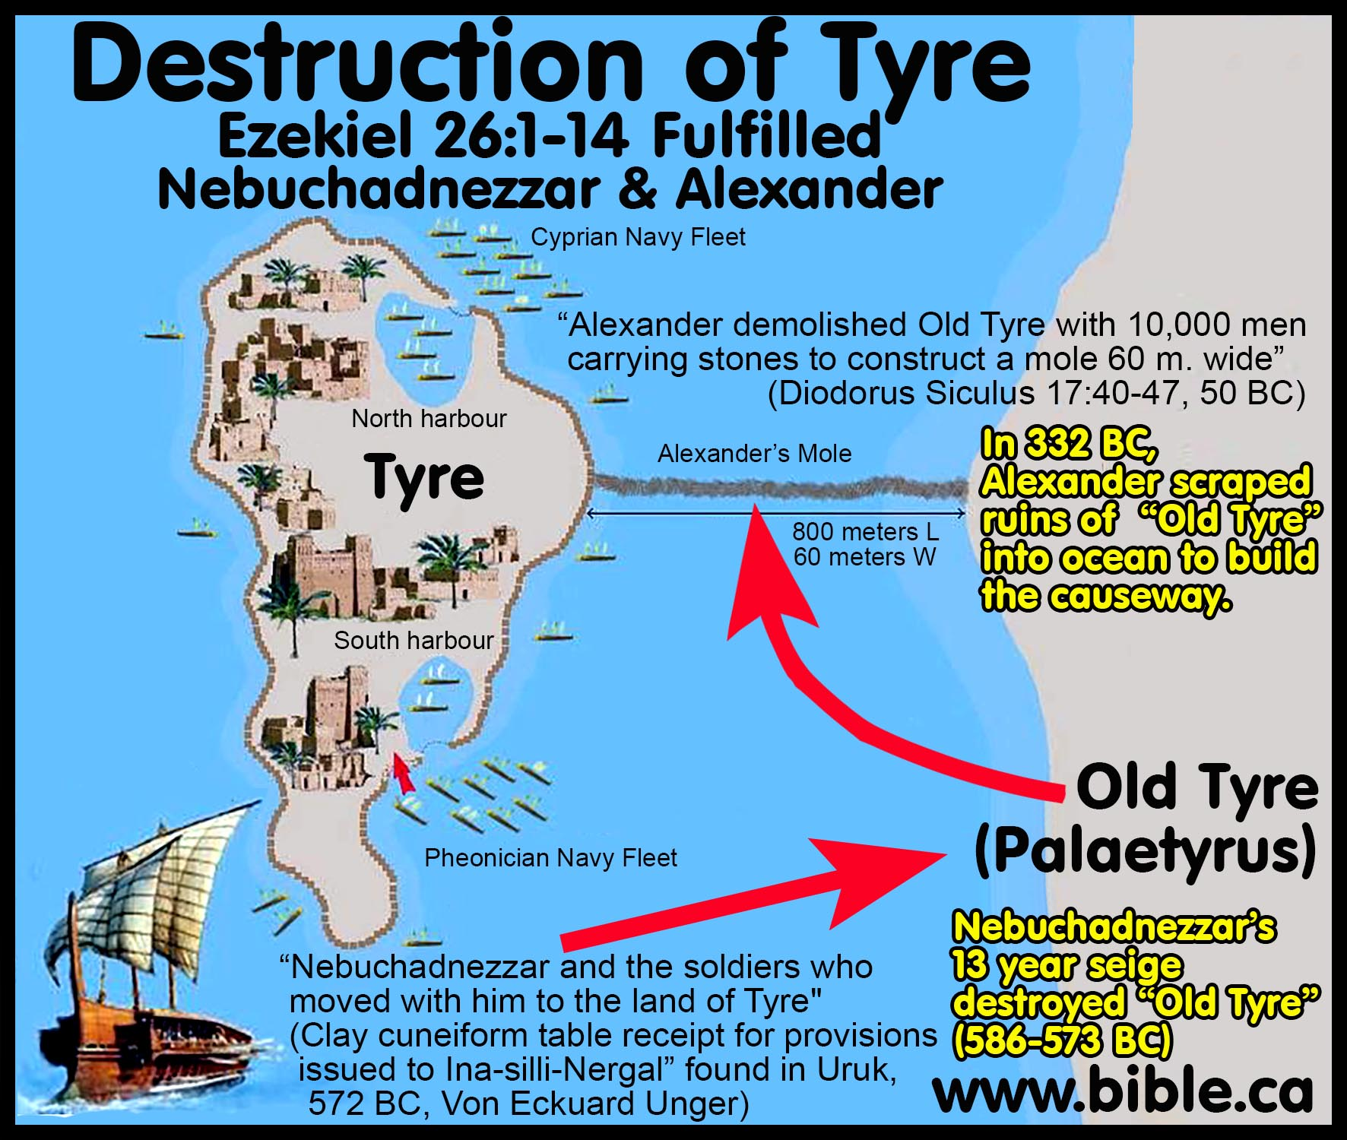

Slide 7
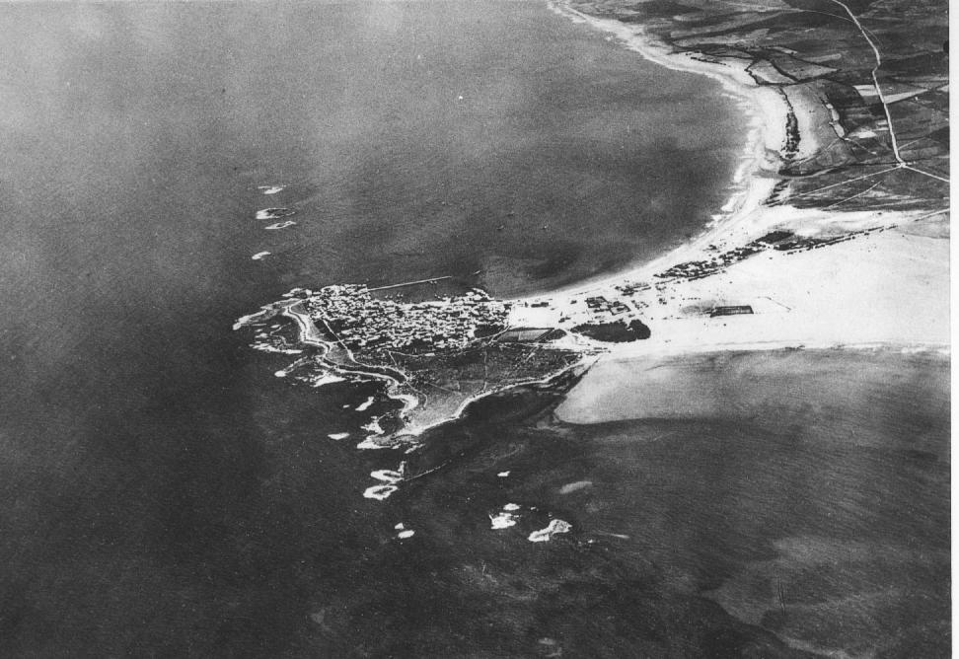
Aerial photo of Tyre made by French Air Force before 1934. File:Tyre-aerial-photo-by-France-Military-1934.jpg, (Public Domain)

Slide 8
SPECIFIC PROPHECIES AND THEIR FULFILLMENT …
Nineveh in prophecy … Isaiah 10:12-14 (740-700 BC); Zephaniah 2:13-15 (circa 625 BC); Nahum, (circa 625-612 BC)
To be captured when its rulers were drunken
(Nahum 1:10; 3:11)
Destruction to be total (Nahum 1:9).
Flooding of the river to be a factor (Nahum 1:8; 2:6).
Fire associated with destruction (Nahum 2:13; 3:13).
Shepherds to bring flocks there (Zephaniah 2:14).
Those passing would hiss and wag the hand in amazement (Zephaniah 2:15).

Slide 9
SPECIFIC PROPHECIES AND THEIR FULFILLMENT …
Nineveh in prophecy …
Fulfilled:
Nineveh fell in 612 BC. Empire fell in 605 BC under Babylonians.
High flooding eroded the walls of the city.
The Babylonian Chronicles say the victors “carried off much spoil from the city and temple-area and turned the city into a ruin-mound and heap of debris …”
cf. Nahum 1:9
Today shepherds graze their sheep on the ruins of this ancient world capital.

Slide 10
SPECIFIC PROPHECIES AND THEIR FULFILLMENT …
Babylon in Prophecy. Isaiah 13:17-22 (740-700 BC); Jeremiah 50-51 (627-585 BC)
Medes to completely overthrow. (Isaiah 13:17-19).
Never to be inhabited (Isaiah 13:20-22;
Jeremiah 51:26).
Arab refuses to pitch his tent there (Isaiah 13:20).
City to become as heaps (Jeremiah 51:37).
Wild beast to lie down there (Isaiah 13:21-22).

Slide 11
SPECIFIC PROPHECIES AND THEIR FULFILLMENT …
Babylon in Prophecy.
Fulfilled
Cyrus the Mede-Persian captured Babylon
(539 BC – Cyrus Cylinder records the conquest).
Babylon has not been inhabited for more than 2,000 years.
The Arab does not yet pitch his tent there.
Shepherds do not bring their flocks there.
Wild beast live where kings and queens once walked.

Slide 12
Evidences of Inspiration.
The Unity of the Scriptures.
1. Sixty-six books of the Bible, written by about 40 different men, over a period of nearly 1,600 years.
2. Men from different countries, speaking different languages, from different backgrounds, yet they present one central theme, without variation or contradiction.
  a. Many of these had no access to the other books of the Bible dealing with events of their own time, yet they wrote in perfect unity, each complementing what the others had written.
  b. Compare this to the writings of other religious writers (Book of Mormon, Writings of the Watchtower, etc.)
Unguided men could not have written with this degree of unity.

